Slide 1


GARBAGE DISPOSABLE MANAGEMENT
REPORT

Slide 2
VISHVNATH KUMAR
M.Sc. Economics and Management
mse23010@iiitl.ac.in
Indian Institute of Information Technology Lucknow

Slide 3

CONTENT:
About Garbage Disposal Management
Survey Overview
Survey Discussion and Analysis
Conclusion
Thank You

Slide 4
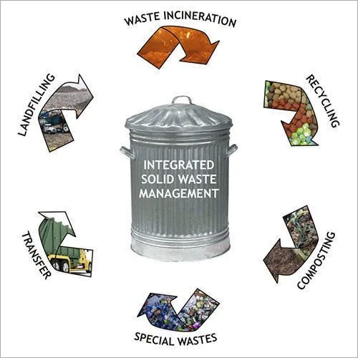
GARBAGE DISPOSAL MANAGEMENT
01
Garbage disposal management, also known as waste management.
GDM is the process of handling waste from its creation to its final disposal.
The goal of waste management is to reduce the negative effects of waste on the environment and human health.

Slide 5

02
Overview of The
SURVEY

Slide 6
Most households dispose of waste either daily or every
two to three days.
Common disposal methods include door-to-door
collection or dustbin disposal.
Garbage segregation is low, with only a few households separating
waste into wet and dry categories.
The overall satisfaction with waste disposal services is low,
with several respondents expressing dissatisfaction.
Many participants show interest in waste disposal training,
indicating an opportunity for educational initiatives.

Slide 7

SURVEY DISCUSSION
03
AND ANALYSIS

Slide 8
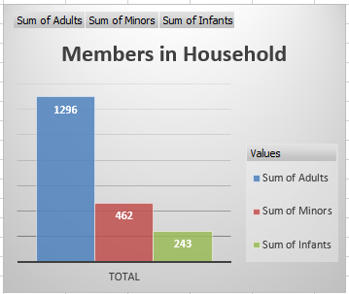
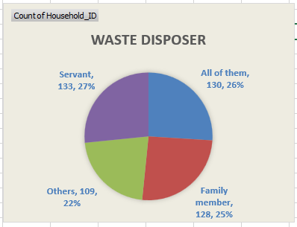
How many members are in Who disposes of the waste?
the households?
In the 500 household there are 1296 Adults, 462 Minors and 243 Infants.
Total members in household are 2001.
Out of 500 household there are 133 that type of households in which Servant is a Waste Disposer, 130 households in which all of them dispose the waste, 128 households in which family member dispose the waste and 109 household has other waste disposer.

Slide 9
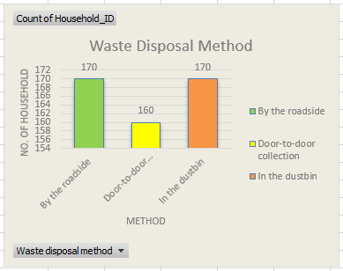
How do you dispose of the waste?
Out of 500 household there are 170 that type of household who dispose the waste by roadside dustbin, 160 by Door-to-Door collection and 170 by in the dustbin.
Analytical Part :- 170 household dispose the waste by the roadside but only 84 household segregate the waste, 74 from the 160 household and 87 from the remaining 170.
For the convenience I used the slicer in the dashboard i.e. fig.2 .

Slide 10
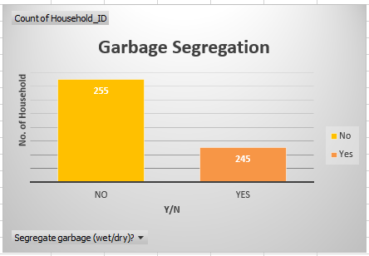
Do you segregate the garbage into wet and dry?
There is less no. of household who segregate the waste garbage i.e. 245 households segregate the garbage and 255 households don’t segregate the garbage.
Analytical Part :- Out of them 41 are that type of households who have low income and they aware about penalty still they don’t segregate the waste.

Slide 11
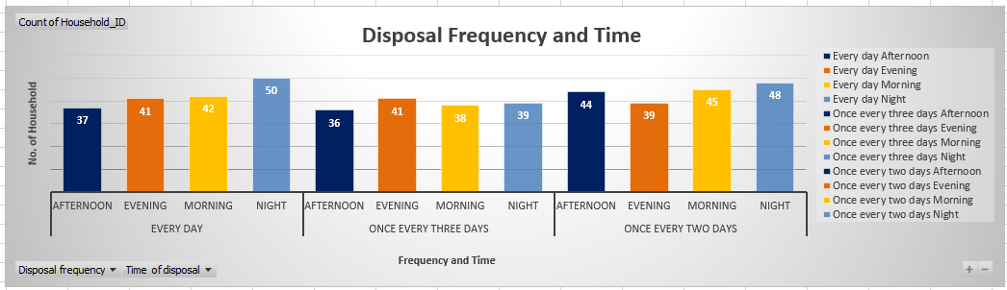
How often do you dispose of the waste?
This is the analysis of dispose the garbage with respect to days and time.
174 households dispose the garbage everyday, 154 households dispose the garbage once every three days and 176, once every two days.
Out of 174, 42 households dispose the garbage in the every morning, out of 154, 38 households dispose the garbage in the morning and out of 176, 45 household dispose the garbage in the morning.

Slide 12
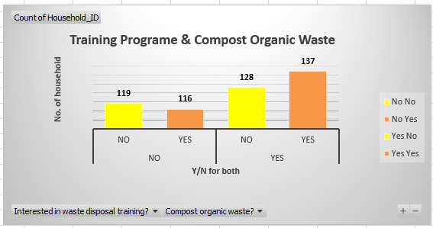
Would you like to attend training on household waste disposal?
Out of 500 households, only 265 households like to attend training session on household waste disposal, remaining don’t.
And 137 households from the 265, they compose the organic waste still they want training session but 119 household from who don’t like training session, they don’t compose organic waste.

Slide 13
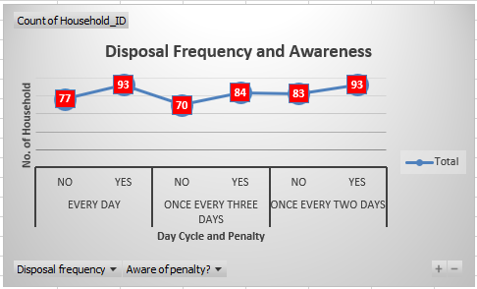
Are you aware of the amount of penalty if you fail to segregate garbage?
Here, there are some households who don’t aware the penalty but they dispose the garbage everyday and also some households knows the penalty still they don’t dispose garbage everyday.

Slide 14
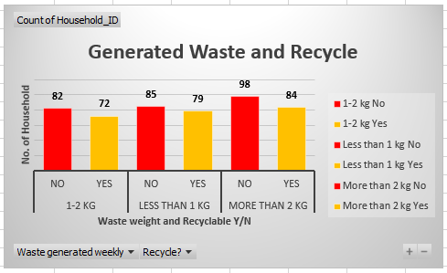
How much weight of garbage is generated?
Analysis Part:- There is 154 households who generates the waste 1-2 KG, out of them only 72 households recycle the waste.
Similarly, 164 households generates the waste less than 1 KG and only 79 recycle the waste.
And 182 household generates the waste more than 2 KG and only 84 recycle the waste.

Slide 15
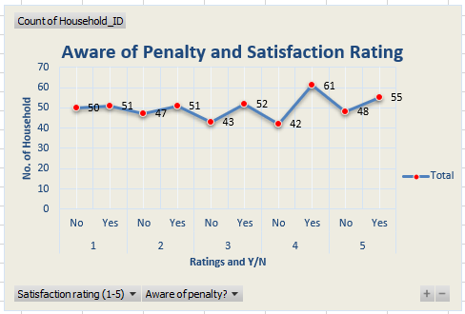
How satisfied are you with the present waste removal system of the government?
Here, 103 households exist who fully satisfied with the waste removal system, 101 households are completely disagree with the waste removal system and 95 households are have moderate type satisfaction.

Slide 16
CONCLUSION…
The survey data from 500 households indicates that waste management practices need significant improvement. Only 245 households (49%) segregate waste, while 255 (51%) do not. Out of 170 households that dispose of waste by roadside bins, only 84 (49%) segregate it. Waste recycling is also low, with 154 households generating 1-2 kg of waste daily, but only 72 (47%) recycle it. Similarly, among 164 households generating less than 1 kg, only 79 (48%) recycle. Satisfaction with government services shows that only 103 households (20.6%) are fully satisfied, while 101 (20.2%) express complete dissatisfaction

Slide 17
THANK YOU
Vishvnath Kumar
Contact No. : 7455047121
E-Mail : kumarvishv@gmail.com
Linkedin : https://www.linkedin.com/in/vishvnathkumar/
GitHub : https://github.com/vishuNkumar

